Slide 1
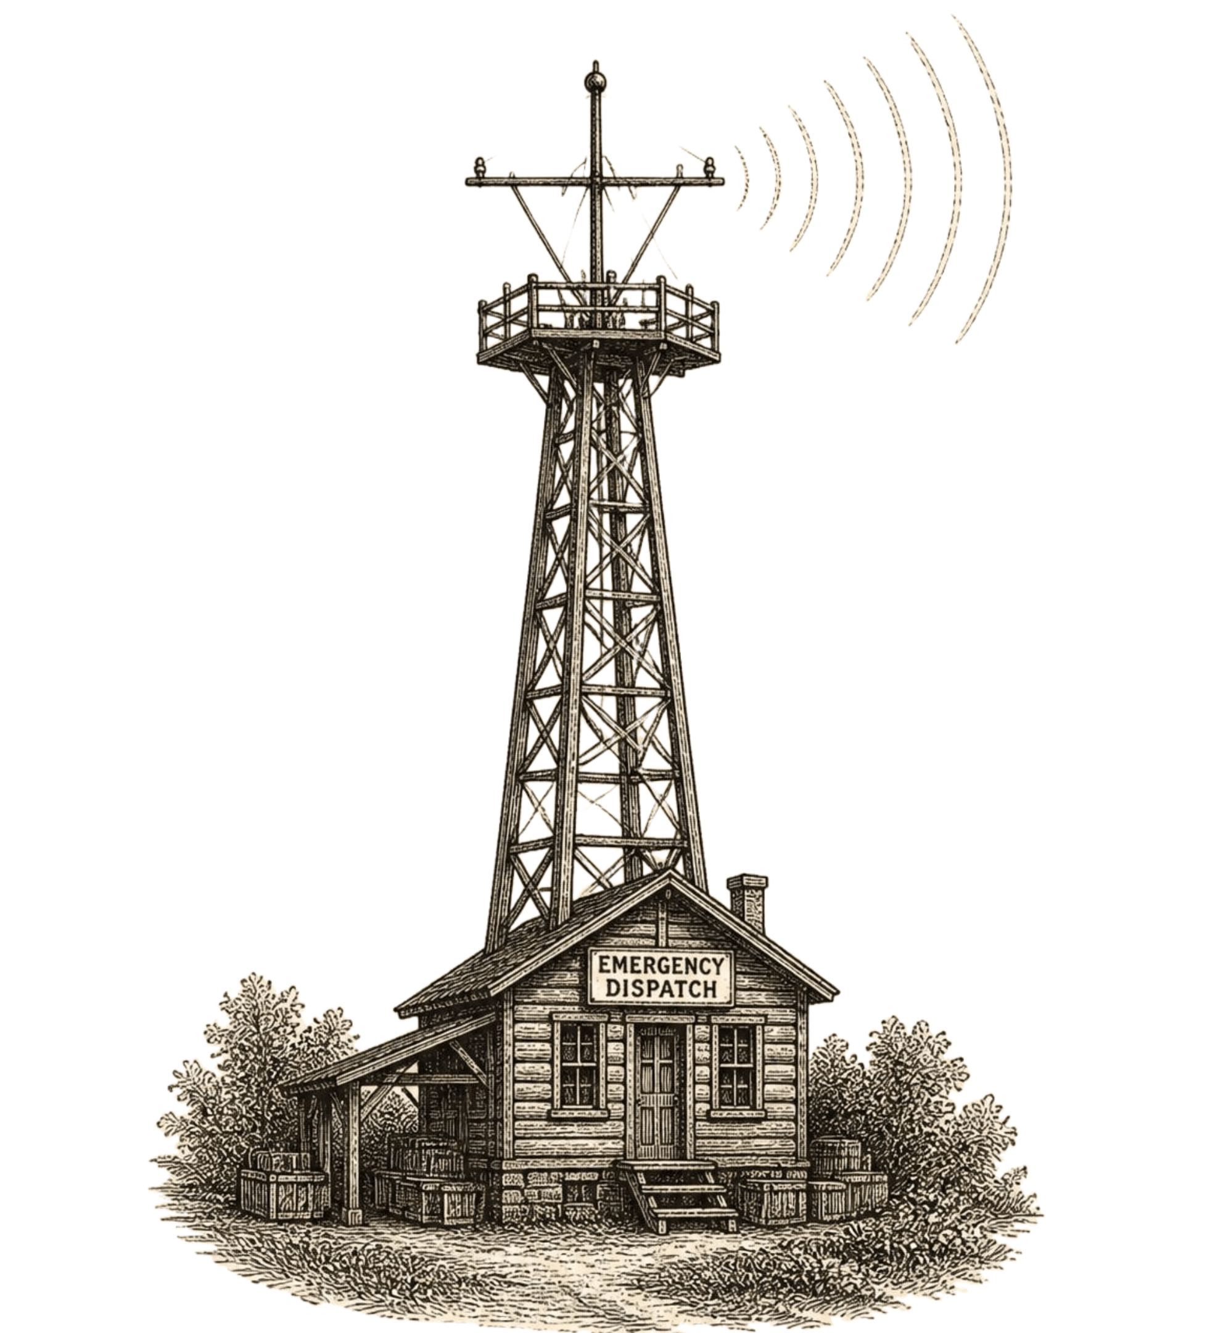
Internship Project Presentation · Nexthikes
Disaster Tweet
Classification
Using NLP and Machine Learning
Internship Project Presentation
Organization: Nexthikes
Submitted by: Raghav Arora
Technology: Python, NLP, Machine Learning
Notes:
Introduce the project: Disaster Tweet Classification Using NLP and Machine Learning, completed during the internship at Nexthikes and submitted by Rawech Arora.

Slide 2
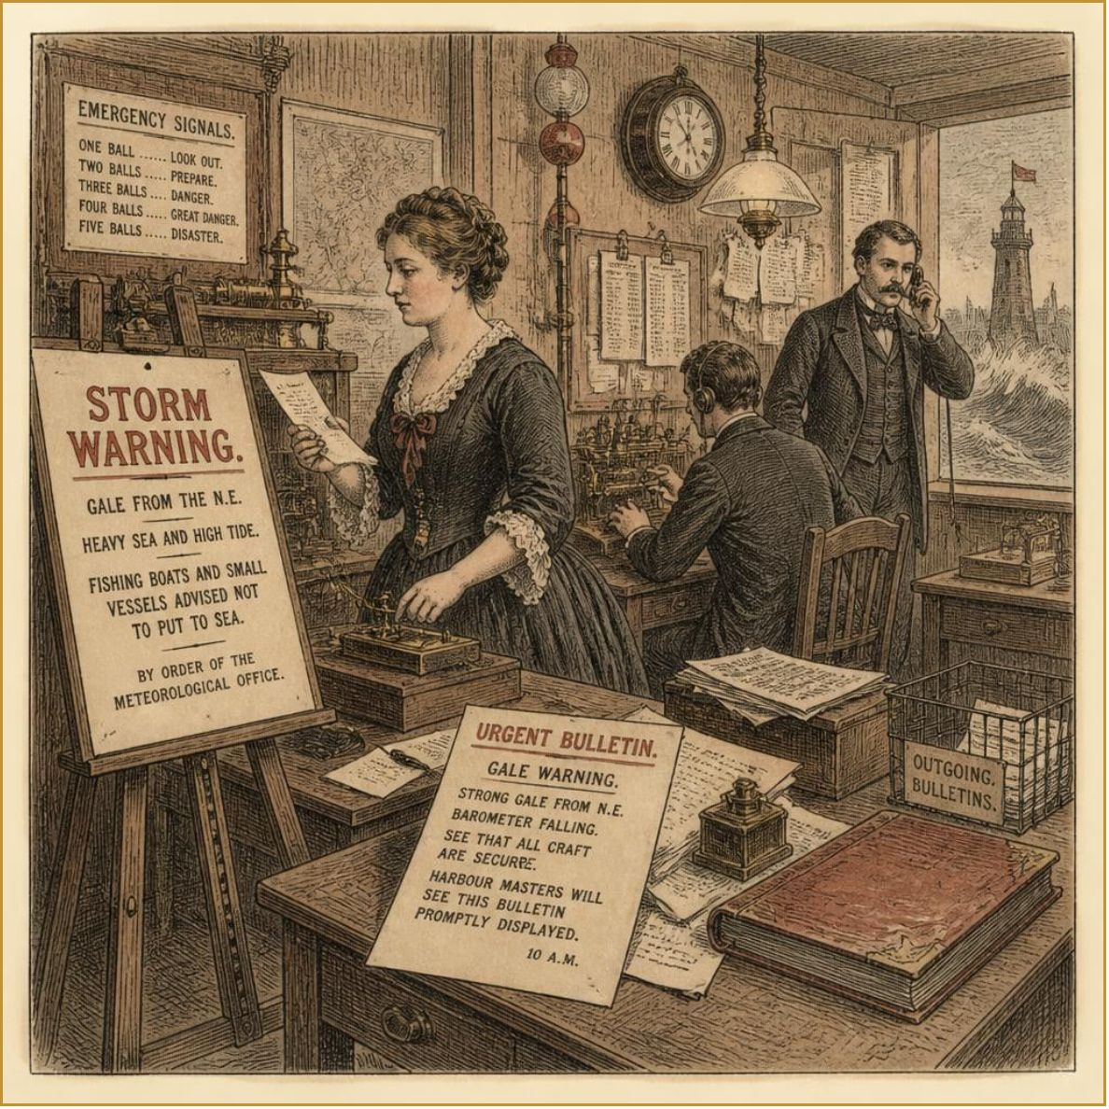
Introduction
Social media platforms provide real-time information during disasters.
Identifying disaster-related tweets manually is time-consuming.
Natural Language Processing (NLP) helps computers understand text.
Machine Learning classifies tweets into disaster and non-disaster categories.
This project automates tweet classification using text data.
Illustration · Urgent dispatch and emergency communication signals.
02
Notes:
Set the context: social platforms provide critical real-time alerts, but manual filtering is slow. NLP and machine learning automate identifying genuine disaster reports.

Slide 3
Problem Statement and Objectives
Problem Statement
Objectives
Classify tweets into disaster and non-disaster categories.
Process text using TF-IDF vectorization.
Train a Logistic Regression model.
Evaluate model performance.
Develop a web application for user input and prediction.
A large number of tweets are generated during emergencies.
It is difficult to identify genuine disaster-related information manually.
03
Notes:
Contrast the acute challenge of high-volume emergency noise with our clear engineering objectives: text transformation, training, evaluation, and end-to-end web deployment.

Slide 4
Dataset Description
Dataset file: tweets.csv
Total records: 7,613 tweets
Total columns: 5
Columns: id, keyword, location, text, target
text: Contains the tweet content.
target: Contains the classification label.
Target Labels
0 – Non-disaster tweet
1 – Disaster-related tweet
04
Notes:
Detail the corpus structure: 7,613 tweets across 5 feature columns, with binary target labels 0 representing non-disaster and 1 indicating genuine disaster events.

Slide 5








Tools and Technologies
Programming Language: Python
Classification Algorithm: Logistic Regression
Data Handling: Pandas
Model Saving: Joblib
Machine Learning: Scikit-learn
Visualization: Matplotlib and Seaborn
Text Vectorization: TF-IDF
Web Framework: Flask
Frontend: HTML and CSS
05
Notes:
Present the engineering stack from core scientific Python, Scikit-learn, and TF-IDF through serialization with Joblib and web serving using Flask.

Slide 6
Methodology
01
Load the dataset using Pandas.
02
Inspect the dataset and target labels.
03
Separate tweet text and target values.
04
Split the dataset into 80% training data and 20% testing data.
05
Convert text into numerical features using TF-IDF.
06
Train the Logistic Regression classifier.
07
Evaluate the model using accuracy, precision, recall, and F1-score.
08
Save the trained model and vectorizer.
09
Integrate the model into a Flask web application.
06
Notes:
Walk through the nine sequential methodology steps from data ingestion and train-test partitioning through TF-IDF representation, model training, evaluation, and web integration.

Slide 7
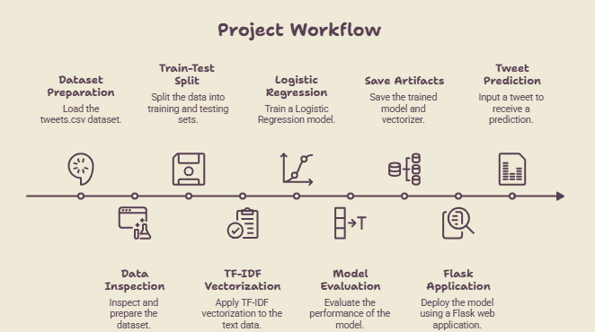
System Architecture
07
Notes:
Trace the overall system architecture from input tweets.csv through vectorization and model inference down to Flask real-time prediction.

Slide 8
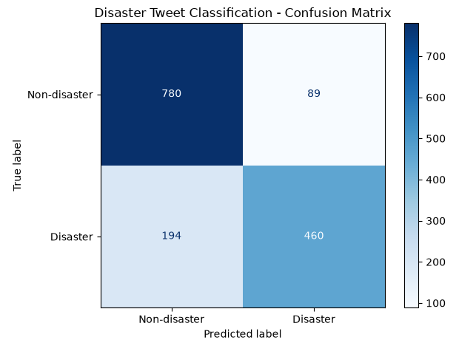
Results and Evaluation
Primary Metric
81.42%
Model Accuracy: 81.42%
Metric | Non-disaster | Disaster
Precision | 0.80 | 0.84
Recall | 0.90 | 0.70
F1-score | 0.85 | 0.76
Observations
The model achieved 81.42% accuracy on the test dataset.
It performed better at identifying non-disaster tweets by recall.
Disaster tweet recall can be improved further.
08
Notes:
Review evaluation figures: 81.42% overall test accuracy, high non-disaster recall at 0.90, and disaster precision of 0.84, with reserved visual placement for the confusion matrix.

Slide 9
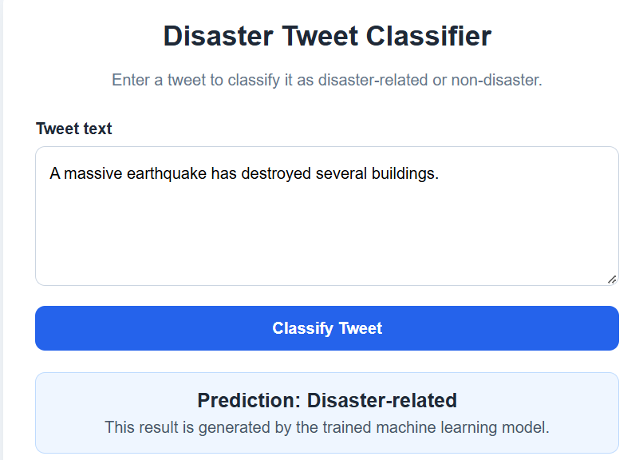
Web Application
Flask-Based Tweet Classification System
Provides a simple interface for entering tweet text.
Converts the input text using the saved TF-IDF vectorizer.
Uses the trained model to predict the category.
Displays either Disaster-related or Non-disaster.
Allows users to test different tweets.
Example Input: “Flood water is rising in the nearby streets.”
Expected Output: Disaster-related
09
Notes:
Demonstrate the interactive Flask web application, showing text input processing via serialized TF-IDF and Logistic Regression prediction output.

Slide 10
Conclusion and Future Scope
Conclusion
Future Scope
Developed a tweet classification system using NLP and Machine Learning.
Used TF-IDF and Logistic Regression for text classification.
Achieved 81.42% test accuracy.
Integrated the model into a Flask web application.
Experiment with advanced NLP models such as BERT.
Improve disaster tweet recall.
Support multiple languages.
Integrate real-time tweet collection.
Extend the system for disaster monitoring.
Notes:
Conclude the presentation by summarizing core accomplishments and outlining prospective extensions including transformer models like BERT, multilingual classification, and live stream ingestion.

